Slide 1

Cafe Quest
Chase Solano, Hiwete Teshale

Slide 2
Project Overview
A coffee shop finder for UNCG students
@uncg.edu email verification
Users can display their Major
Main User-side UI is an interactive map with popular coffee shops in the area
Google Maps API
Users can schedule events at coffee shops for other users to see/RSVP
Provider-side UI allows management of both users and events

Slide 3
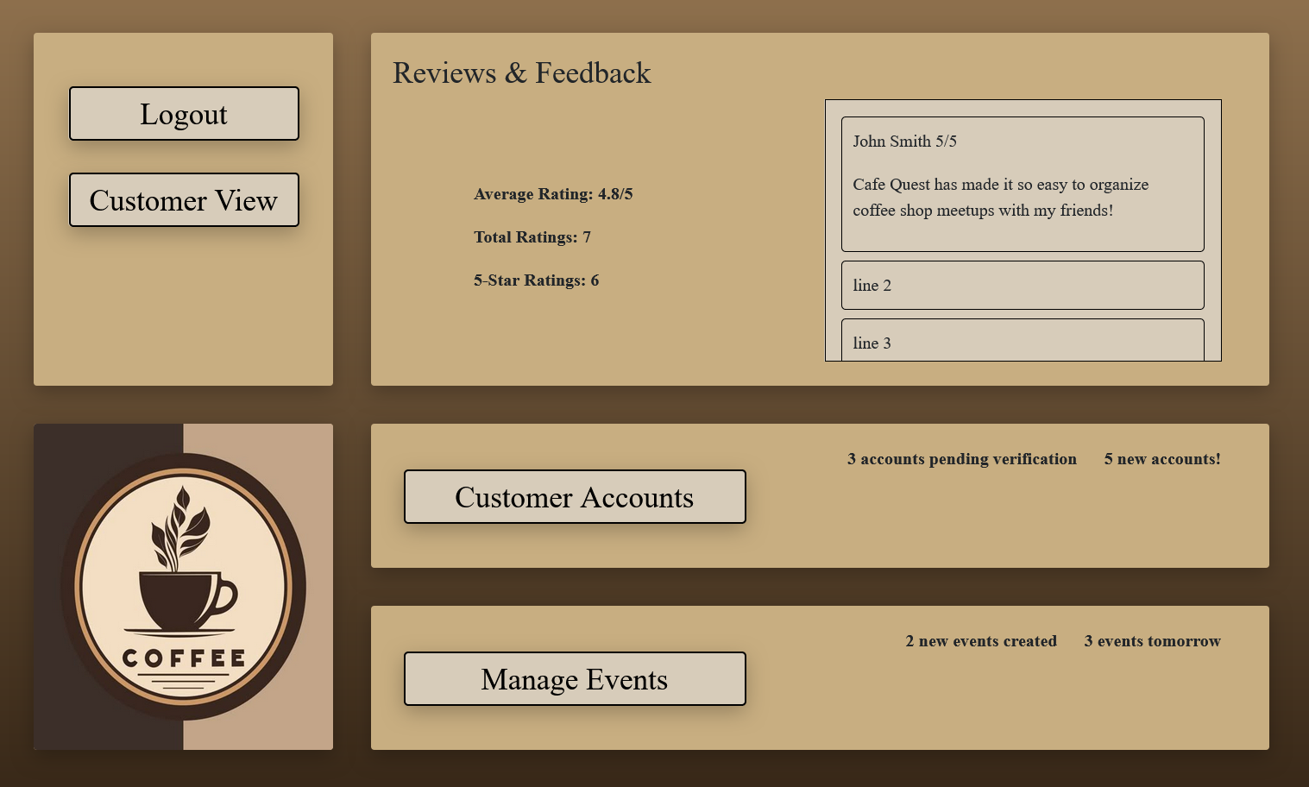
Provider Side
Separate login page from users
Manages user reviews
Review summary with rating averages, # of 5-star ratings
Oversees posted events
Can manage the visibility of posted events as needed
Manages user accounts
Access to overview information about users
Can add/remove users

Slide 4
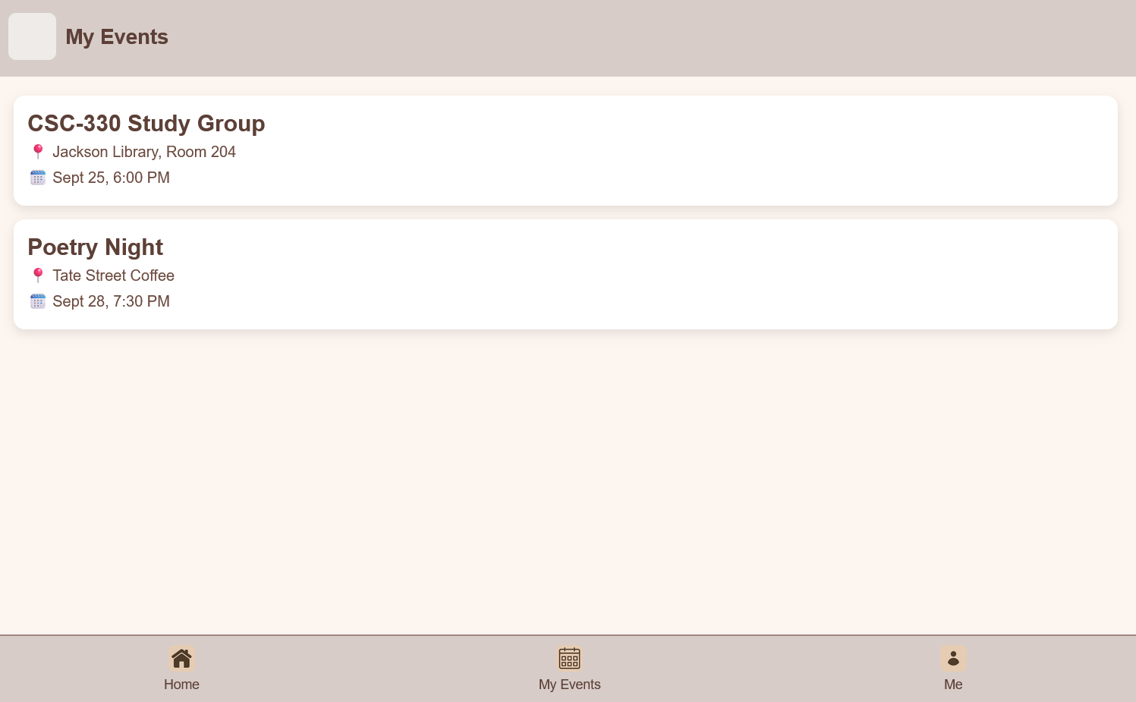
User Side
Must have a UNCG email in order to sign up
Finding coffee shops other UNCG students love
Users can leave reviews that other users can see while exploring the map
Users can create events to post to specific cafes

